Slide 1
INTRAOPERATIVE ERRORS
DR S KALYANI SURYA DHANA LAKSHMI
ADDL PROFESSOR & HOD
DEPT OF ANAESTHESIOLOGY
AIIMS BIBINAGAR

Slide 2


LINE OF CONTROL

Slide 3

COMMON GROUND
PATIENT

Slide 4
Scope of the problem
Causes
Why
How to prevent it

Slide 5

Surgical procedures are a major contributor to patient harm
.
An estimated 8–10% of surgical patients experience preventable harm, with the majority of errors attributable to various human factors (HF)
Human factors is a scientific discipline that applies theory, principles, design, data and methods to optimize human well-being and overall system performance in all work settings
PanagiotiM,KhanK,KeersRNetal.Prevalence,severity,andnature of preventable patient harm across medical care settings: systematic review and meta-analysis. BMJ2019;366: l4185

Slide 6
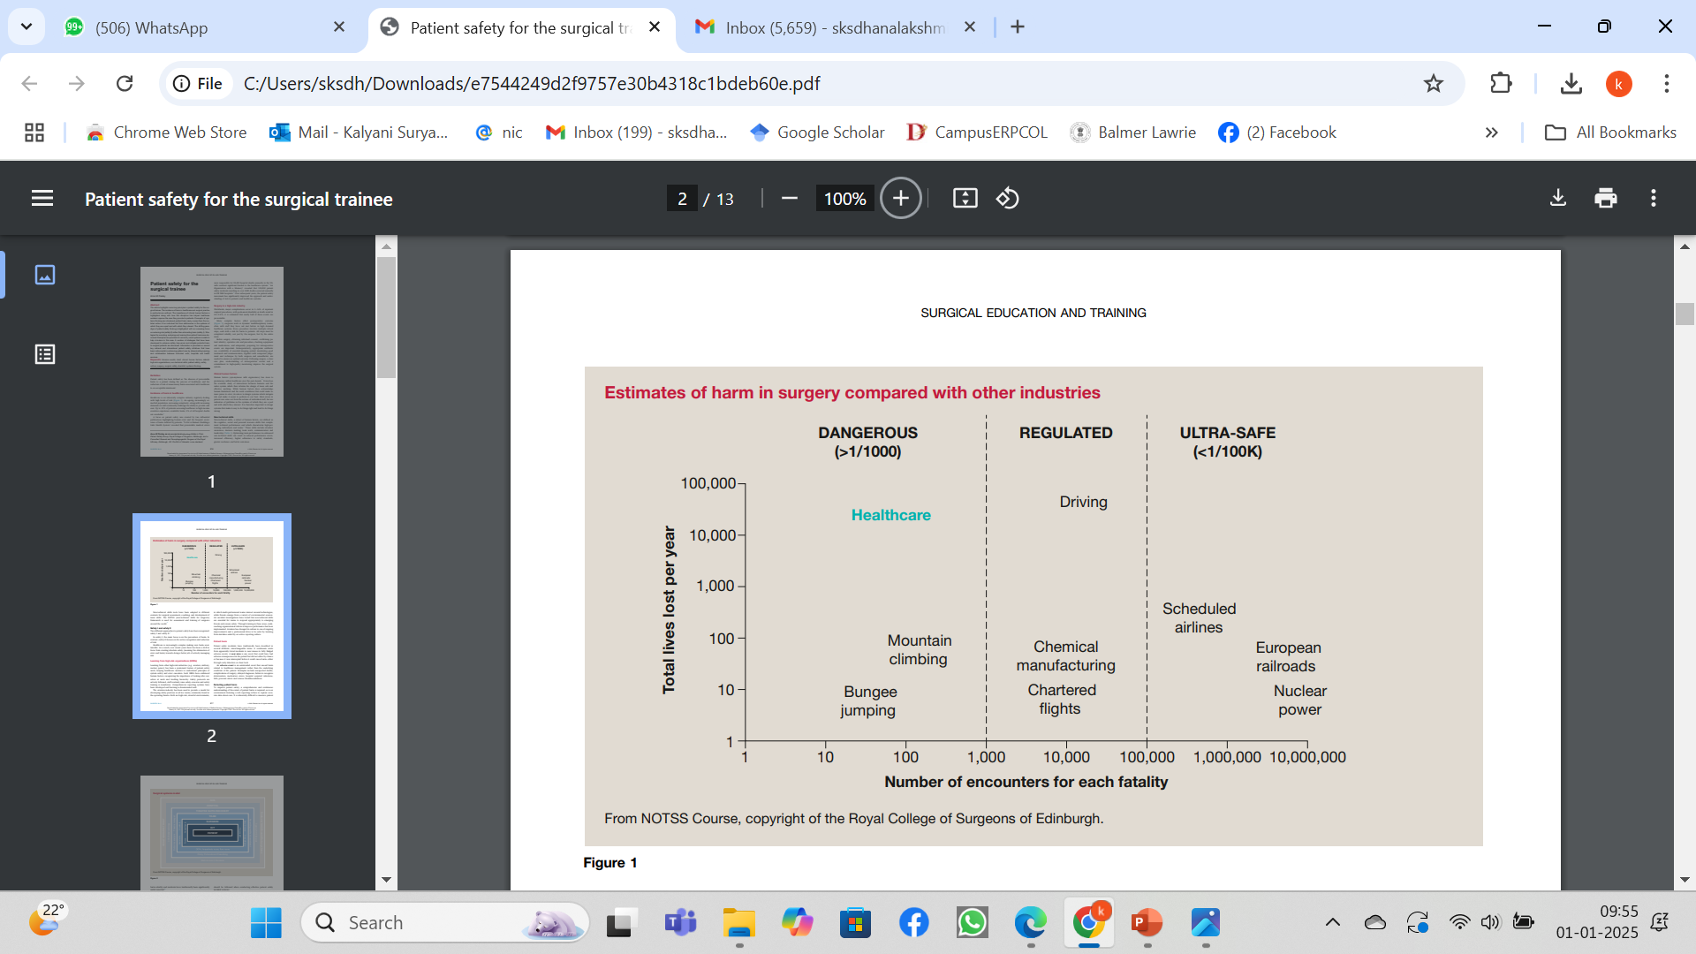

Slide 7
A critical incident in anesthesia is defined as any untoward and preventable mishap associated with the administration of general or regional anesthesia, and which leads to, or could have led to an undesirable patient outcome.
A surgical error is an unintentional, preventable injury occurring in the perioperative period that is not considered a known acceptable risk of surgery and could have been avoided by following appropriate procedure-specific training protocols.

Slide 8
Due to different terminology all the following terms are being considered in CRITICAL INCIDENTS.
Adverse events
Errors
Medication errors
Harm

Slide 9
Surgical errors are a type of medical error and include retained foreign bodies, mislabeled surgical specimens, and wrong-site, wrong-procedure, and wrong-patient errors (WSPEs)

Slide 10
Serious surgical errors such as wrong-site surgery and retention of foreign objects (RFOs) are so-called never events that are potentially devastating in scope, cost, and impact on human health.
Mehtsun WT, Ibrahim AM, Diener-West M, Pronovost PJ, Makary MA. Surgical never events in the United States. Surgery. 2013;153(4):465-472. doi:10.1016/j.surg.2012.10.005

Slide 11
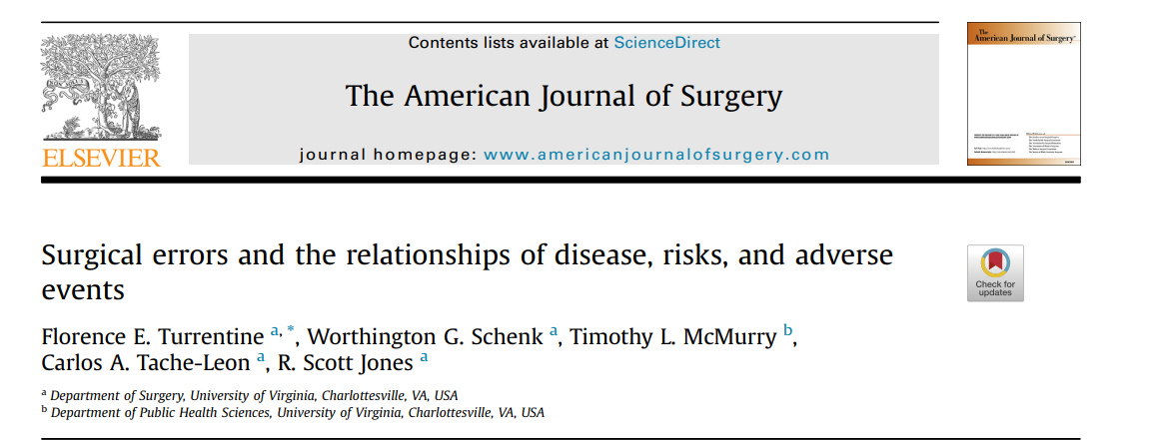

Slide 12
84 deaths occurred following 5,209 operations.
Errors in care (63%) compared to those without had significantly more adverse events, (98% vs 80% respectively, p ¼ 0.004).
Significant association occurred between error and emergency status, p ¼ 0.016); length of stay >10 days, p ¼ 0.011; adverse events, p ¼ 0.005).
Regression results indicated number of adverse events (OR ¼ 1.27, 95% CI (1.08e1.49),p ¼ 0.003) and length of stay (OR ¼ 1.05, 95% CI (1.01e1.09), p ¼ 0.008) were associated with surgical errors

Slide 13
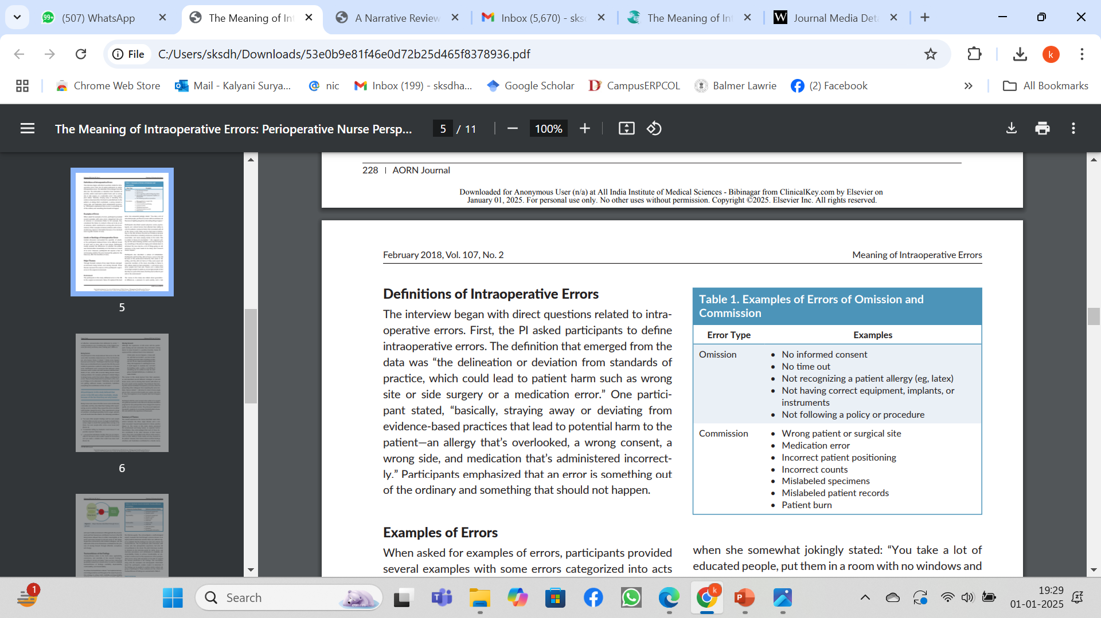
Diagnostic error
Judgement error
Technique error
Omission error
System error
Medication error, or other errors occurred,

Slide 14
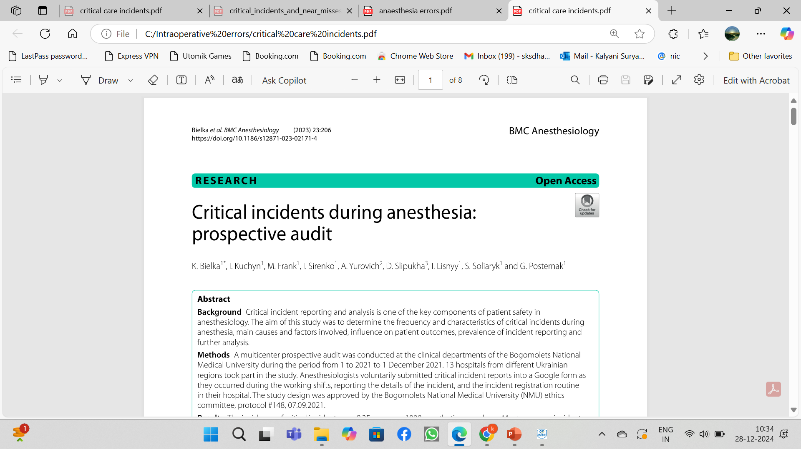

Slide 15
The incidence of critical incidents was 9.35 cases per 1000 anesthetic procedures.
Most common incidents were related to the
Respiratory and Cardiovascular system

Slide 16
Respiratory system:
difficult airway (26.8%)
reintubation (6.4%)
oxygen desaturation (13.8%)

Slide 17
Cardiovascular system:
hypotension (14.9%)
tachycardia (6.4%)
bradycardia (11.7%)
hypertension (5.3%)
collapse (3.2%)
massive hemorrhage (17%)

Slide 18
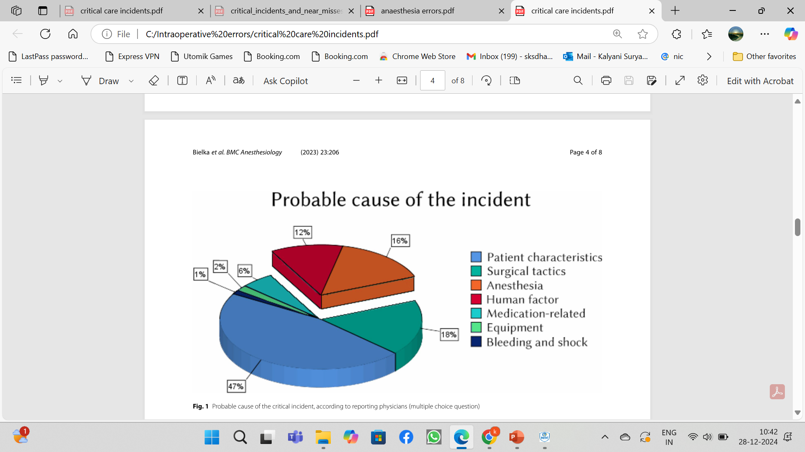

Slide 19
The higher age and ASA status were associated with critical incidents.
Procedural sedation increased the risk of critical incident, compared to general anesthesia.

Slide 20
The most frequent failings contributing to the incident occurrence were:
  insufficient preoperative assessment (44%)
  incorrect interpretation of the patient’s state (33%)
  faulty manipulation technique (14%)
  miscommunication with surgical team (13%)
  delay in emergency care (10%).

Slide 21
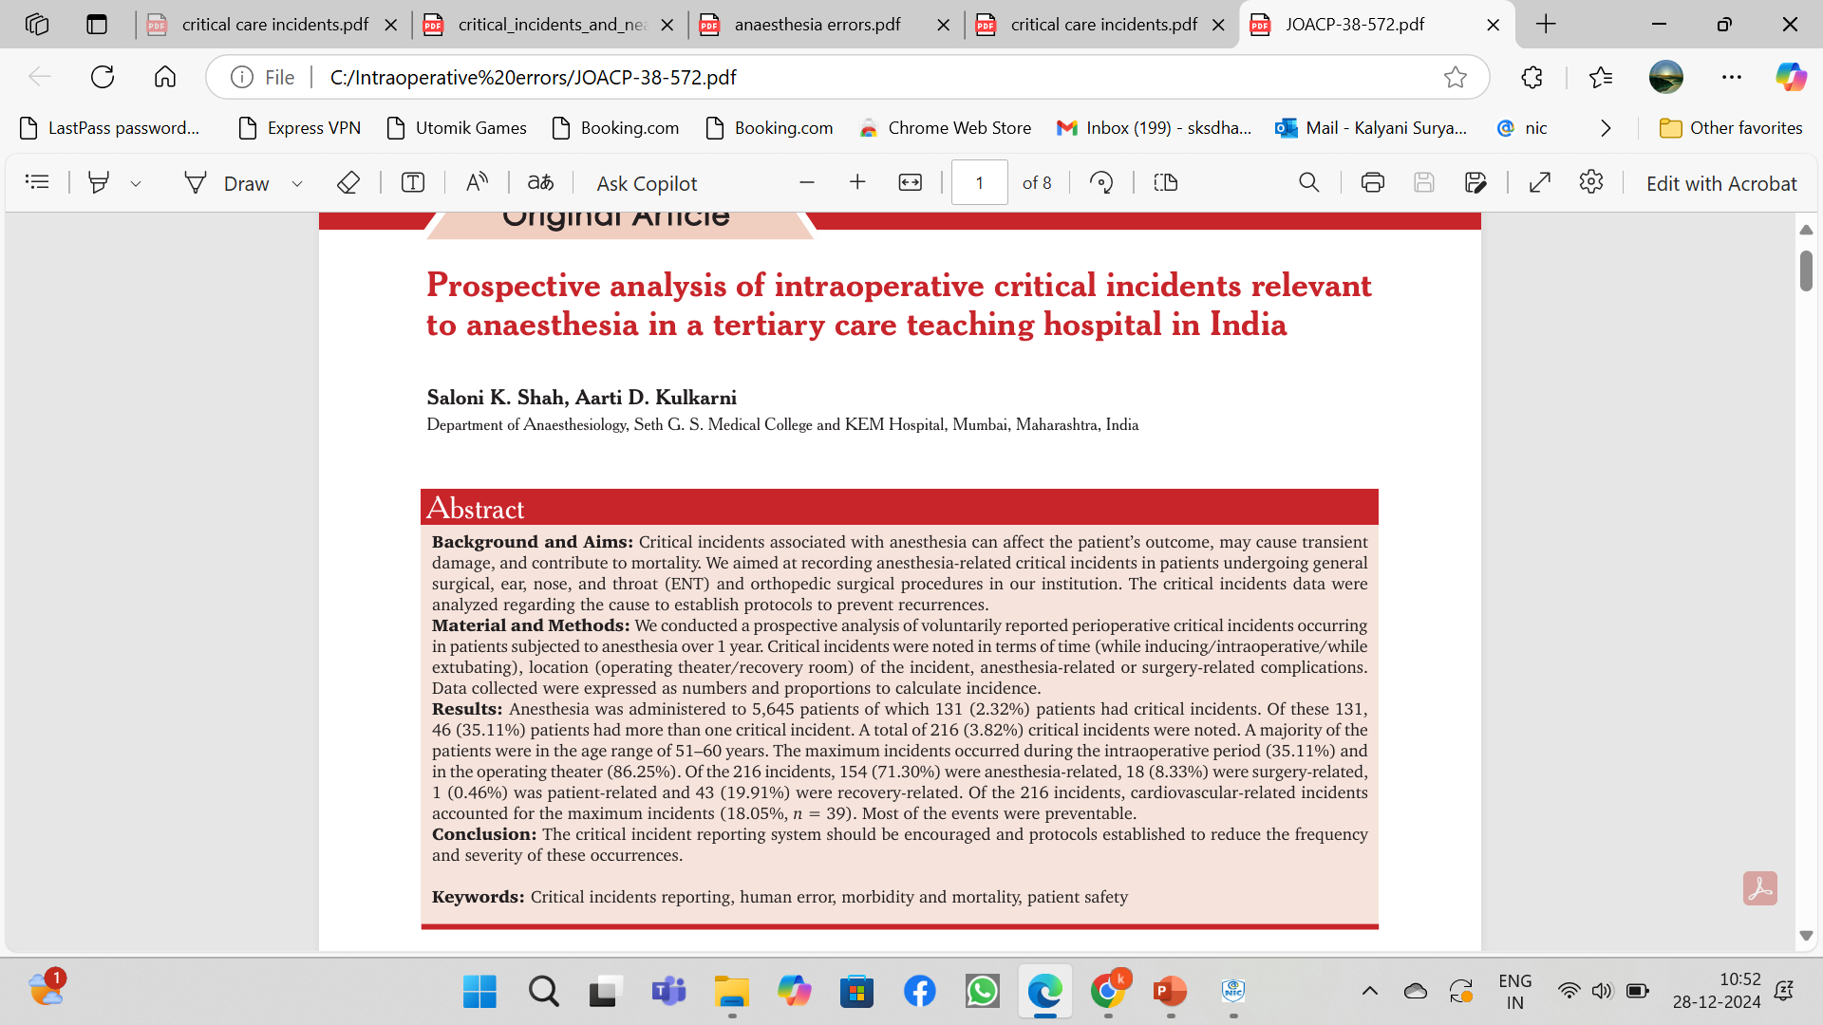

Slide 22
Checklists and mental rehearsal improve technical skills and completion of vital tasks, but do not fully account for the non-technical requirements of critical events.

Slide 23
NON TECHNICAL SKILLS FOR SURGEONS(NOTSS)
ANAESTHESIA NON TECHNICAL SKILLS (ANTS)

Slide 24
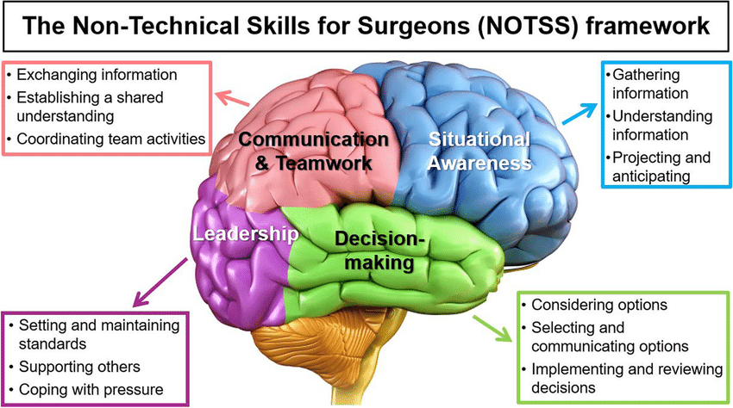

Slide 25
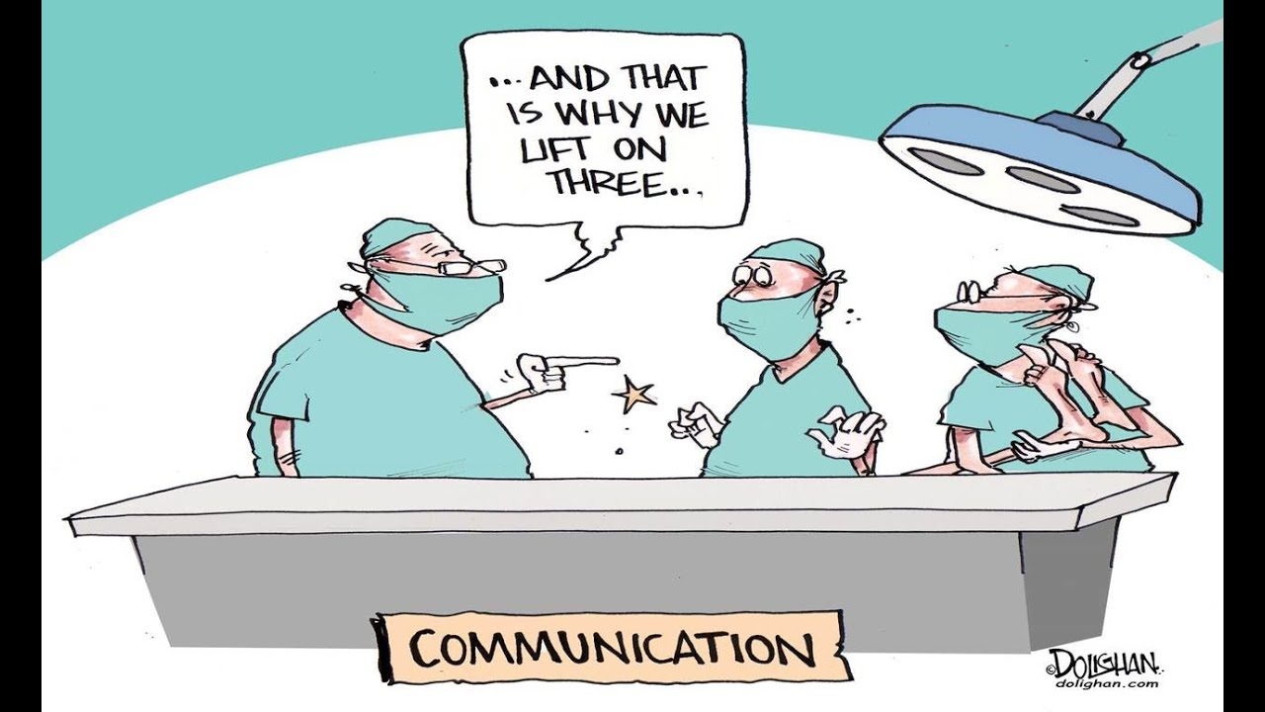

Slide 26
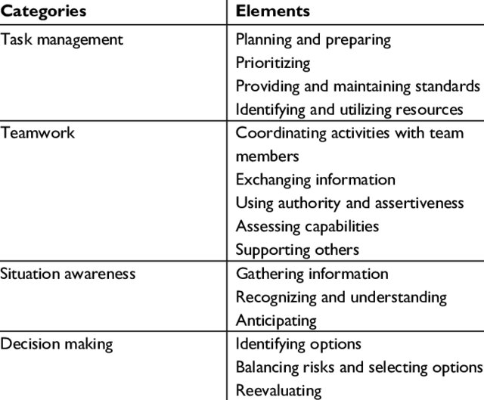
ANTS

Slide 27
SITUATIONAL AWARENESS (SA)
Early recognition of an unfolding critical event and a safe response are vital to prevent or worsen patient harm.
Maintaining operating theatre SITUATIONAL AWARENESS is key to early critical-event recognition and aids subsequent decision-making.

Slide 28
A high-pressure situation may lead to poor decision-making as the workload exceeds one’s personal cognitive capacity, or inappropriate decisions are made due to acute stress reactions (fight–flight or freeze hide) and limbic hijacking events (surprise and startle).

Slide 29
The ‘Plane, Path, People’ (PPP) tool is a simple Threat and Error management cognitive aid used in aviation to improve SA, manage developing critical events and aid decision-making

Slide 30
Situational awareness
Situational awareness is knowing what is happening outside the immediate task being undertaken.
Loss of SA in the operating theatre occurs during crisis situations in both trainees and more senior surgeons.
GraaflandM,Schraagen JM,Boermeester MAet al. Training situational awareness to reduce surgical errors in the operating room. Br J Surg 2015; 102:16–23.

Slide 31
During a crisis event SA degrades, and ‘tunnel vision’ can occur.
Auditory processing is frequently the first input to be ignored, causing poor communication.
This increases the risk of error exacerbation as the surgeon may not receive useful information from the team, or may not recognise, for example, that the patient is becoming anaesthetically unwell while the focus is on the surgical site.

Slide 32
Initial actions: finding a place of safety.

Slide 33
In surgery, initial actions may include
  packing a bleeding surgical site with swabs
  removing an incorrectly inserted implant before cement or glue sets,
  tagging a retained broken instrument
  damaged nerve with coloured suture to prevent misplacement.

Slide 34
Patient, Procedure, People

Slide 35
The simple, but systematic mini-brief is a countermeasure to an acute stress reaction and vicious cycles of increasing workload.

Slide 36
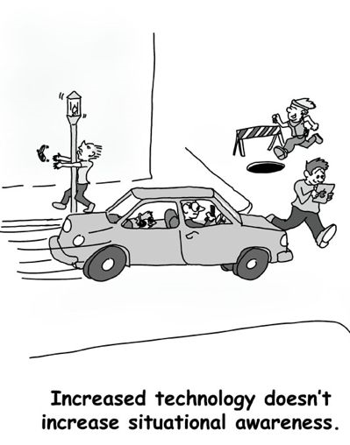

Slide 37
Involving the whole team improves allows effective communication, the flattening of team hierarchy gradients and improved decision-making.

Slide 38
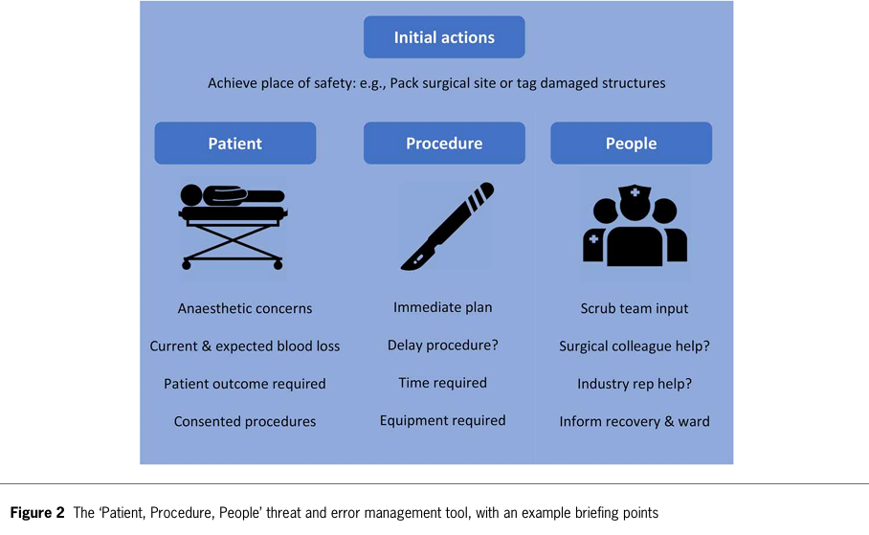

Slide 39
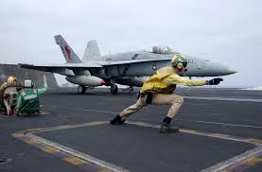
Learning from high-reliability organizations (HROs)
Aviation, Military, Nuclear Power

Slide 40
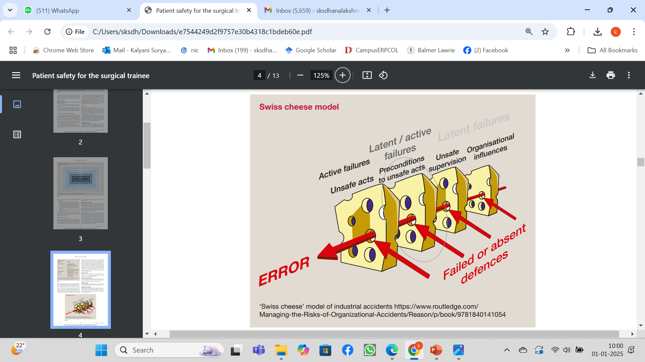

Slide 41
The Human Factors Analysis and Classification System for Healthcare

Slide 42
ROOT CAUSE ANALYSIS

Slide 43
Organizational Influences
Organizational Culture: Shared values, beliefs, and priorities regarding safety that govern organizational decision-making, as well as the willingness of an organization to openly communicate and learn from adverse events.
Operational Process: How an organization plans to accomplish its mission, as reflected by its strategic planning, policies/procedures, and corporate oversight.
Resource Management: Support provided by senior leadership to accomplish the objectives of the organization, including the allocation of human, equipment/facility, and monetary resources

Slide 44
Supervisory Factors
Inadequate Supervision: Oversight and management of personnel and resources, including training, professional guidance, and engagement.
Planned Inappropriate Operations: Management and assignment of work, including aspects of risk management, staff assignment, work tempo, scheduling, etc.
Failed to Correct Known Problem: Instances in which deficiencies among individuals or teams, problems with equipment, or hazards in the environment, are known to the supervisor yet are allowed to continue unabated.
Supervisory Violations: The willful disregard for existing rules, regulations, instructions, or standard operating procedures by managers or supervisors during the course of their duties.

Slide 45
Preconditions for Unsafe Acts
Environmental Factors
Tools and Technology: This category encompasses a variety of issues, including the design of equipment and controls, display/interface characteristics, checklist layouts, task factors, and automation.
Physical Environment: This category includes the setting in which individuals perform their work and consists of such things as lighting, layout, noise, clutter, and workplace design.
Task: Refers to the nature of the activities performed by individuals and teams, such as the complexity, criticality, and consistency of assigned work

Slide 46
Individual Factors
Mental State: Cognitive/emotional conditions that negatively affect performance such as mental workload, confusion, distraction, memory lapses, pernicious attitudes, misplaced motivation, stress and frustration.
Physiological State: Medical and/or physiological conditions that preclude safe performance, such as circadian dysrhythmia, physical fatigue, illness, intoxication, dehydration, etc.
Fitness for Duty: Off-duty activities that negatively impact performance on the job such as the failure to adhere to sleep/rest requirements, alcohol restrictions, and other off-duty mandates.

Slide 47
Team Factors
Communication: The sharing of information among team members including providing/requesting information and the the use of two-way (positive confirmation) communication.
Coordination: This category refers to the interrelationship among team members including such things as planning, monitoring and providing back-up where necessary.
Leadership: The team leader’s performance of his or her responsibilities such as the failure to adopt a leadership role or model/reinforce principles of teamwork.

Slide 48
Unsafe Acts
Errors
Decision Errors: Goal-directed behavior that proceed as intended, yet the plan proves inadequate or inappropriate for the situation. These errors typically result from a lack of information, knowledge or experience.
Skill-based Errors: These “doing” errors occur frequently during highly practiced activities and appear as attention failures, memory failures, or errors associated with the technique with which one performs a task.
Perceptual Errors: Errors that occur during tasks that rely heavily on sensory information which is obscured, ambiguous or degraded due to impoverished environmental conditions or diminished sensory system.

Slide 49
Violations
Routine Violations: Often referred to as “bending the rules,” this type of violation tends to be habitual by nature, engaged in by others, and tolerated by supervisor and management.
Exceptional Violations: Isolated departures from authority, neither typical of the individual nor condoned by management

Slide 50
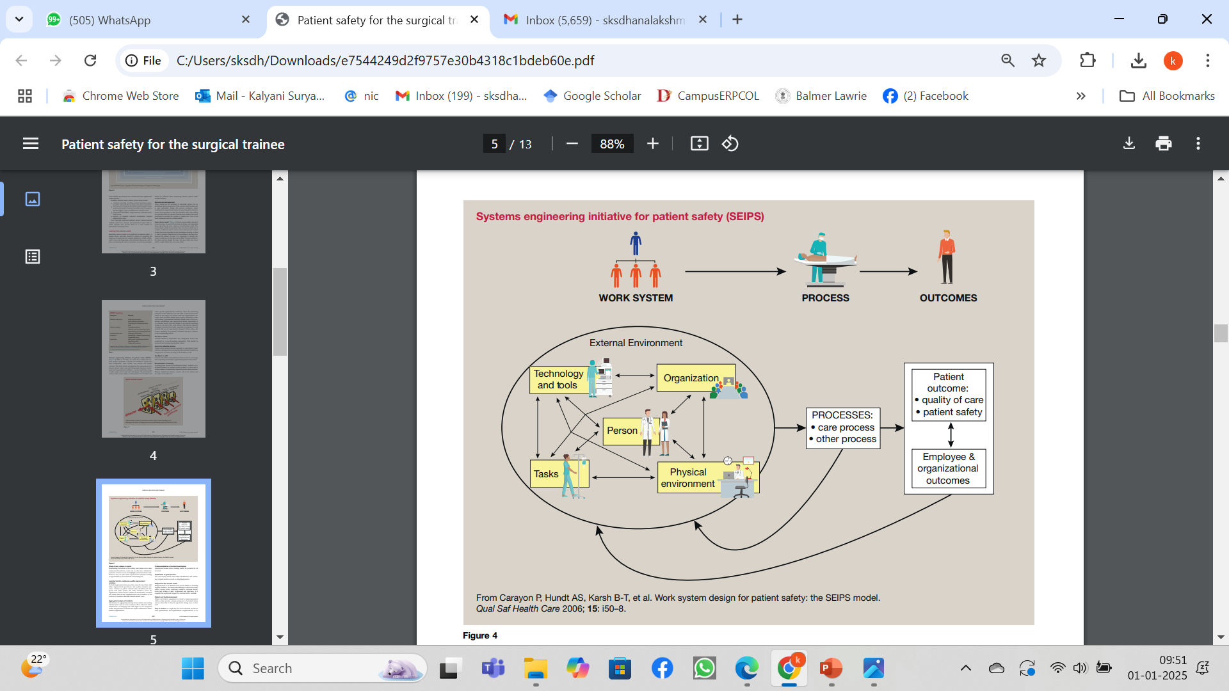

Slide 51
Efforts to reduce or eliminate errors and integrate just culture ultimately culminate in a “high-reliability organization”—HRO

Slide 52

JUST CULTURE
“Just culture”is an environment where workers feel safe enough and accountable enough to engage in the prevention of errors.

Slide 53
PREVENTION OF ERRORS
(1) preoccupation with failure and never being satisfied
(2) resistance to simplifying observations and experiences—diving below the surface to look for complexity and risk
(3) engagement of the front-line workers and those most involved in an operation to report any deviation from expected performance
(4) resilience—the capability to recognize errors quickly and contain them, allowing rapid normalization and improvement
(5) deference to expertise—identifying and giving authority for decision making to those with the greatest expertise to manage an issue.

Slide 54


Slide 55
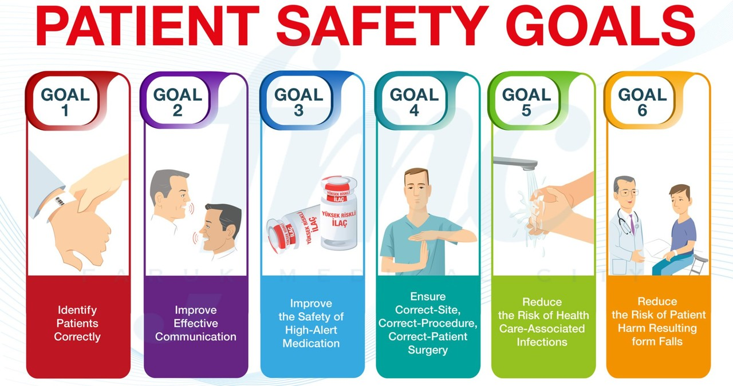
THANK U

